Slide 1

Scaling Security:
What Shifting Left
Was Supposed
To Mean

Slide 2
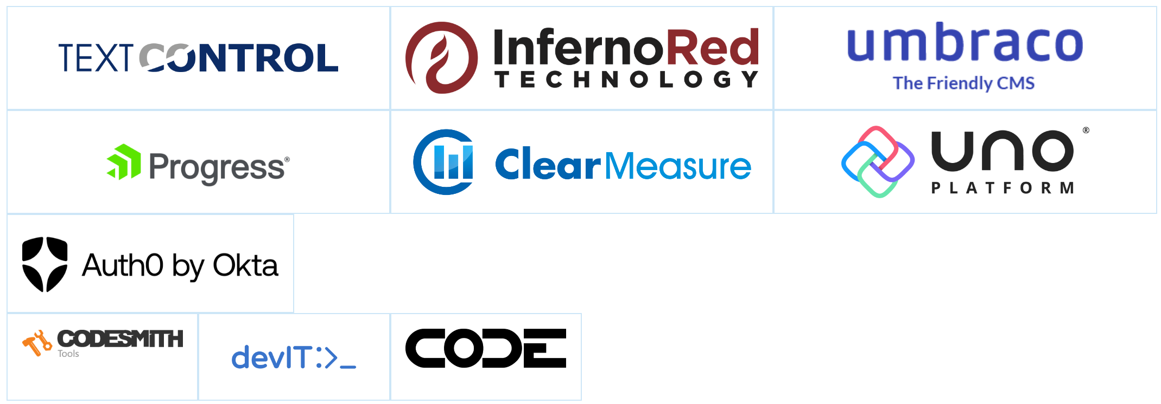
Thank you TechBash 2023 Sponsors!

Slide 3



Hi, I’m Dwayne
I live in Chicago
I’ve been a Developer Advocate since 2016
Co-host of The Security Repo Podcast
On Twitter @mcdwayne
mcdwayne@mastodon.social
Happy to chat about anything, hit me up
Outside of tech, I love improv, karaoke and going to rock and roll shows!
Dwayne McDaniel

Slide 4

About GitGuardian
GitGuardian is the code security platform for the DevOps generation.
—
Main focus: "Where are my hardcoded secrets, have they leaked, and who is working on remediation?"

Slide 5
What Does Good Security Look Like?

Slide 6

Notes:
https://unsplash.com/photos/MtBsjmC4RT0

Slide 7
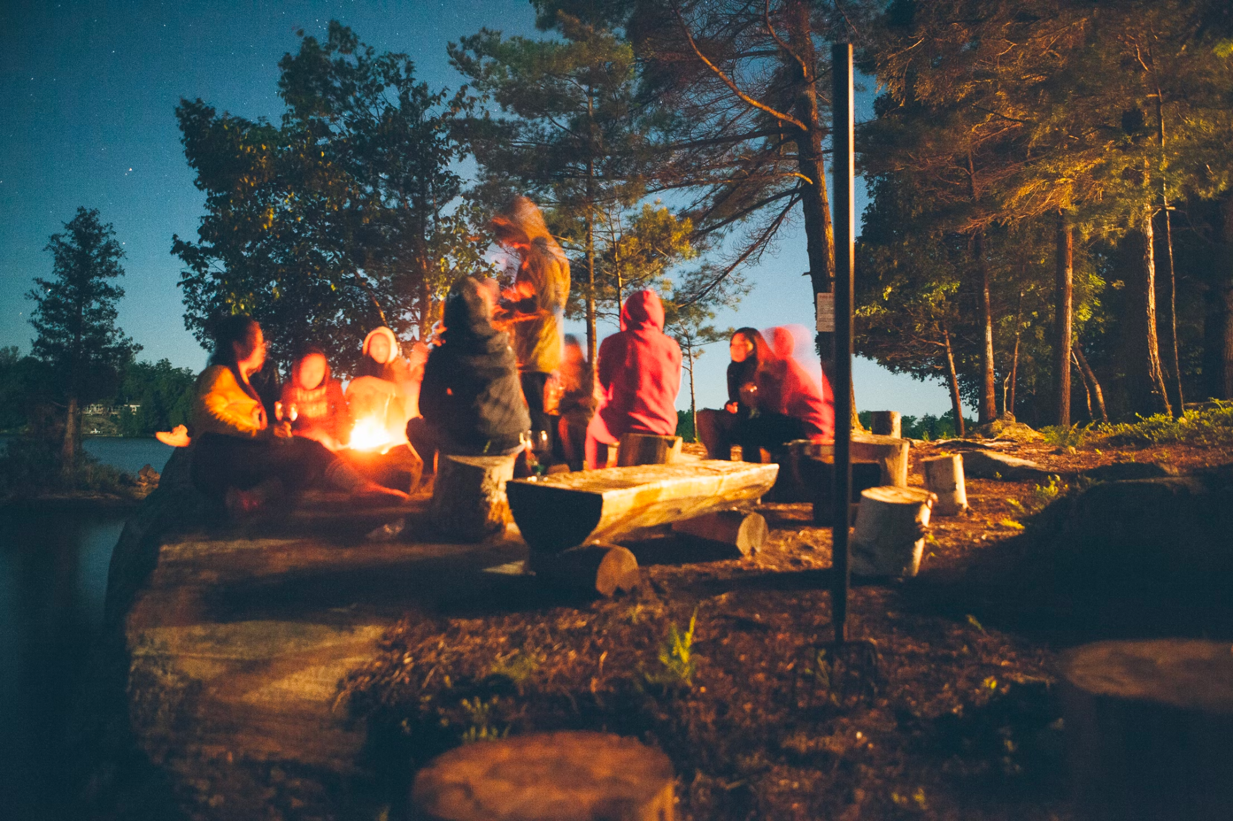
Notes:
https://unsplash.com/photos/fDostElVhN8

Slide 8

Notes:
https://unsplash.com/photos/VJVsEnR_vNE

Slide 9
A Quick Poll
Who is familiar with the term: "Shifting Left"?

Slide 10
A Quick Poll
Who is familiar with the term: "Shifting Left"?
Who likes the term: "Shifting Left"?

Slide 11
A Quick Poll
Who is familiar with the term: "Shifting Left"?
Who likes the term: "Shifting Left"?
Who does NOT like the term: "Shifting Left"?

Slide 12

Notes:
https://unsplash.com/photos/MtBsjmC4RT0

Slide 13

Notes:
https://unsplash.com/photos/MtBsjmC4RT0

Slide 14
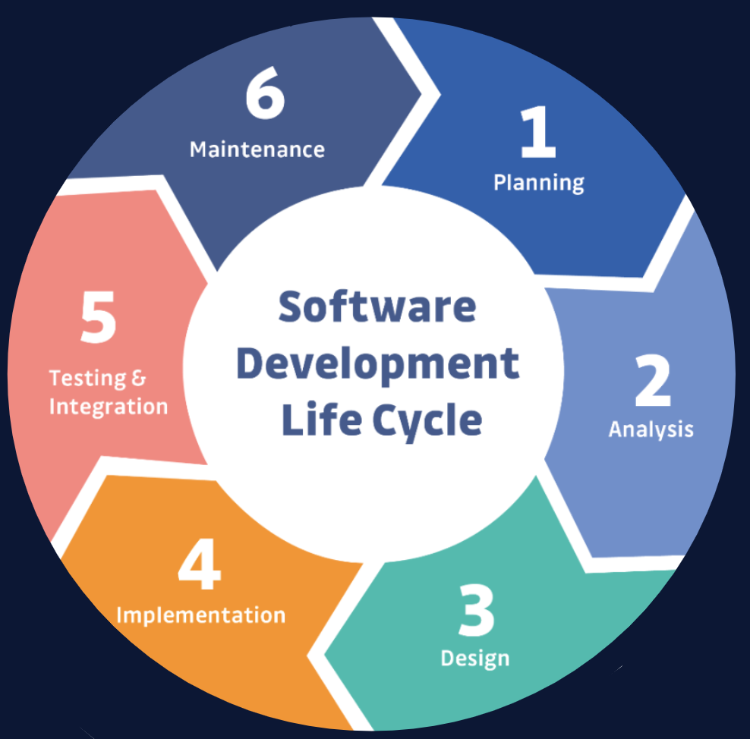
Notes:
https://unsplash.com/photos/MtBsjmC4RT0

Slide 15




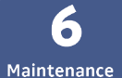

Software Development Lifecycle
Notes:
https://unsplash.com/photos/MtBsjmC4RT0

Slide 16
Where does security fit?
Notes:
https://unsplash.com/photos/MtBsjmC4RT0

Slide 17
Where does security fit?
Notes:
https://unsplash.com/photos/MtBsjmC4RT0

Slide 18
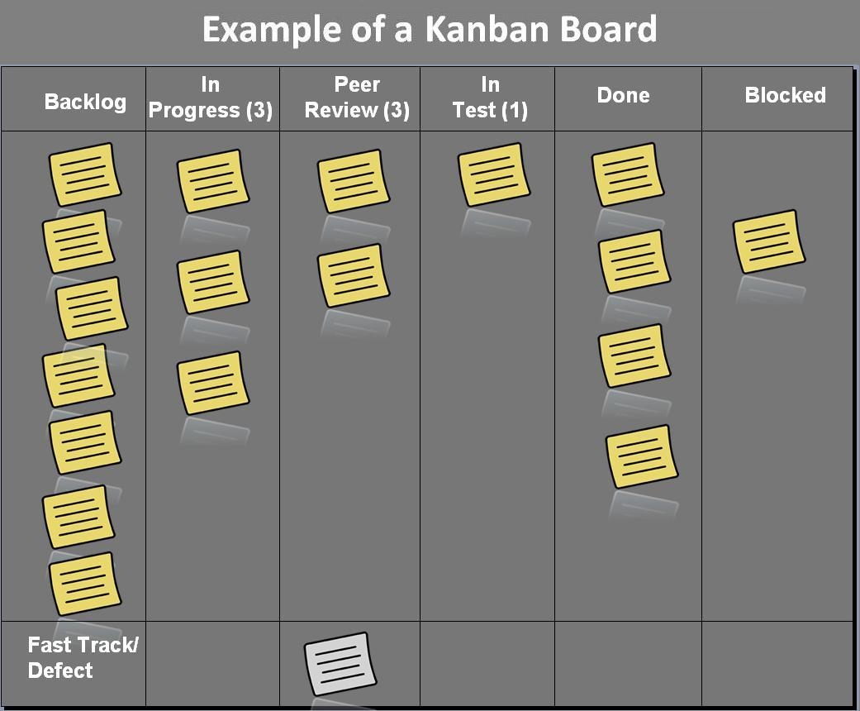
Notes:
https://en.wikipedia.org/wiki/Kanban_board

Slide 19


Notes:
https://en.wikipedia.org/wiki/Kanban_board

Slide 20

Notes:
https://commons.wikimedia.org/wiki/Category:Detour_signs#/media/File:CR106WestboundDetour1.jpg

Slide 21


Slide 22
DORA Metrics Basics
The 4 Metrics:
Deployment Frequency
Mean Lead Time for Changes
Mean Time to Recover
Change Failure Rate
Notes:
https://unsplash.com/photos/MtBsjmC4RT0

Slide 23
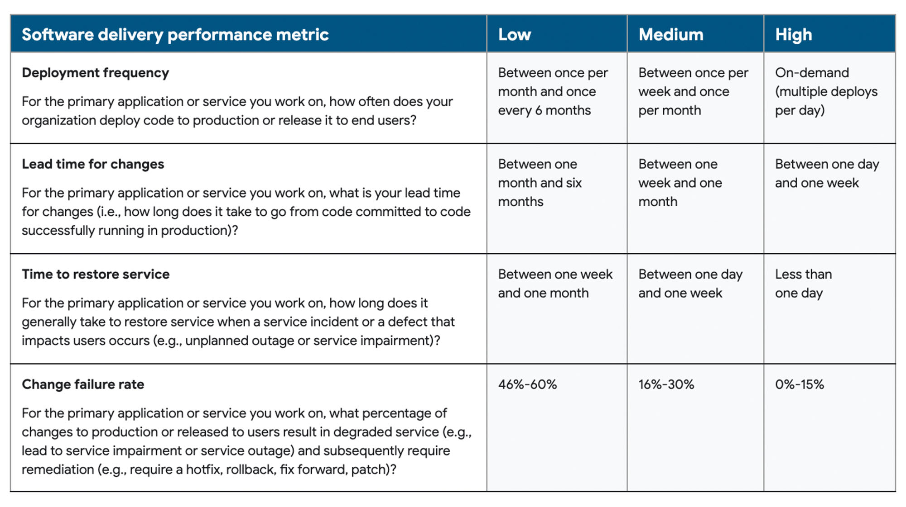
Notes:
https://cloud.google.com/blog/products/devops-sre/dora-2022-accelerate-state-of-devops-report-now-out

Slide 24
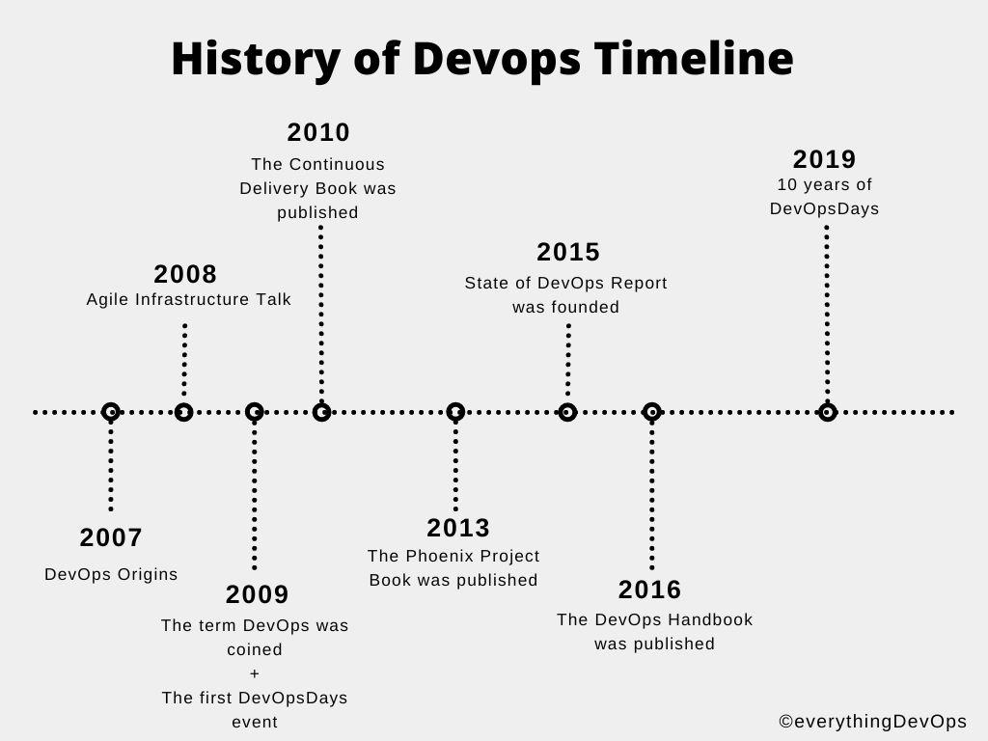
A Too Brief History of DevOps
https://everythingdevops.dev/a-brief-history-of-devops-and-its-impact-on-software-development/
Notes:
https://everythingdevops.dev/a-brief-history-of-devops-and-its-impact-on-software-development/

Slide 25


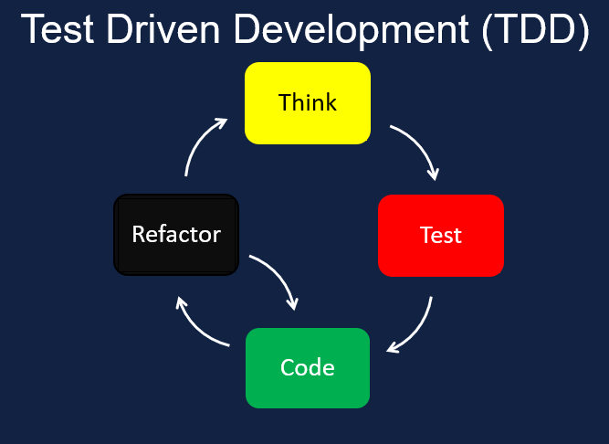



DevOps Solutions to Bottlenecks
Notes:
https://www.kaizenko.com/what-is-test-driven-development-tdd/ https://en.wikibooks.org/wiki/High_School_Earth_Science/Weathering#/media/File:Weathering_and_surface_area.png

Slide 26
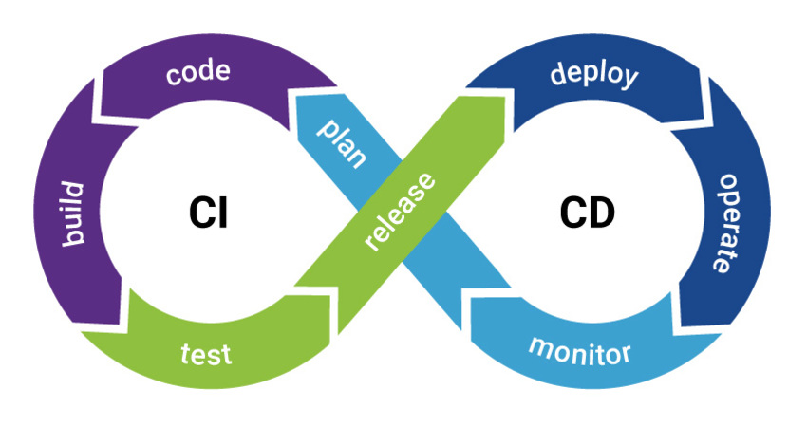
Notes:
https://biplus.com.vn/ci-cd-pipeline-tools/

Slide 27

Ok, but I thought this
was a security talk…

Slide 28
Where does security fit?
Notes:
https://unsplash.com/photos/MtBsjmC4RT0

Slide 29
Notes:
https://cloud.google.com/blog/products/devops-sre/dora-2022-accelerate-state-of-devops-report-now-out

Slide 30
What if we add security everywhere?
Notes:
https://unsplash.com/photos/MtBsjmC4RT0

Slide 31
Shifting Left = Introducing Security Earlier In The Software Development Lifecycle
Notes:
https://unsplash.com/photos/MtBsjmC4RT0

Slide 32
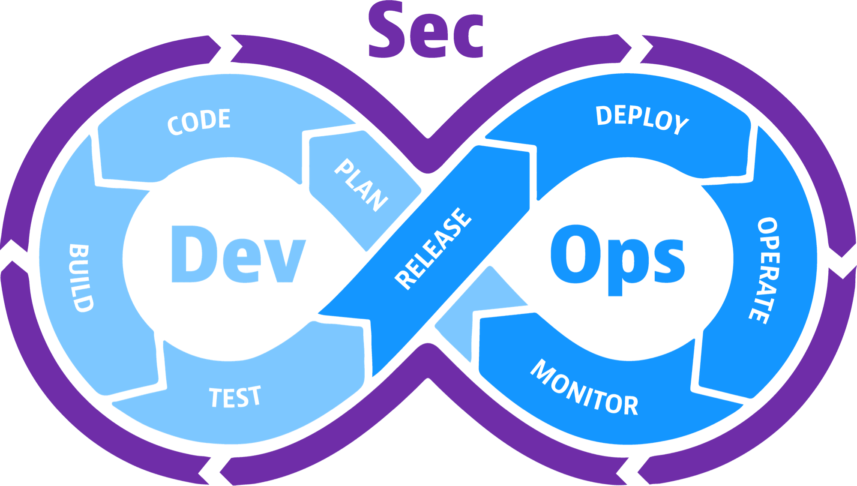
DevSecOps
DevOps + Security
Notes:
1976

Slide 33
In the best organizations developers outnumber security team members 100:1 - Alex Rice, HackerOne #Security@2022 🕺🕺🕺🕺🕺🕺🕺🕺🕺🕺🕺🕺🕺🕺🕺🕺🕺🕺🕺🕺
🕺🕺🕺🕺🕺🕺🕺🕺🕺🕺🕺🕺🕺🕺🕺🕺🕺🕺🕺🕺
🕺🕺🕺🕺🕺🕺🕺🕺🕺🕺🕺🕺🕺🕺🕺🕺🕺🕺🕺🕺🚨
🕺🕺🕺🕺🕺🕺🕺🕺🕺🕺🕺🕺🕺🕺🕺🕺🕺🕺🕺🕺
🕺🕺🕺🕺🕺🕺🕺🕺🕺🕺🕺🕺🕺🕺🕺🕺🕺🕺🕺🕺

Slide 34
Some people interpreted "Shift Left!"
to mean
Put everyone on the security team!
Notes:
100 to 1

Slide 35
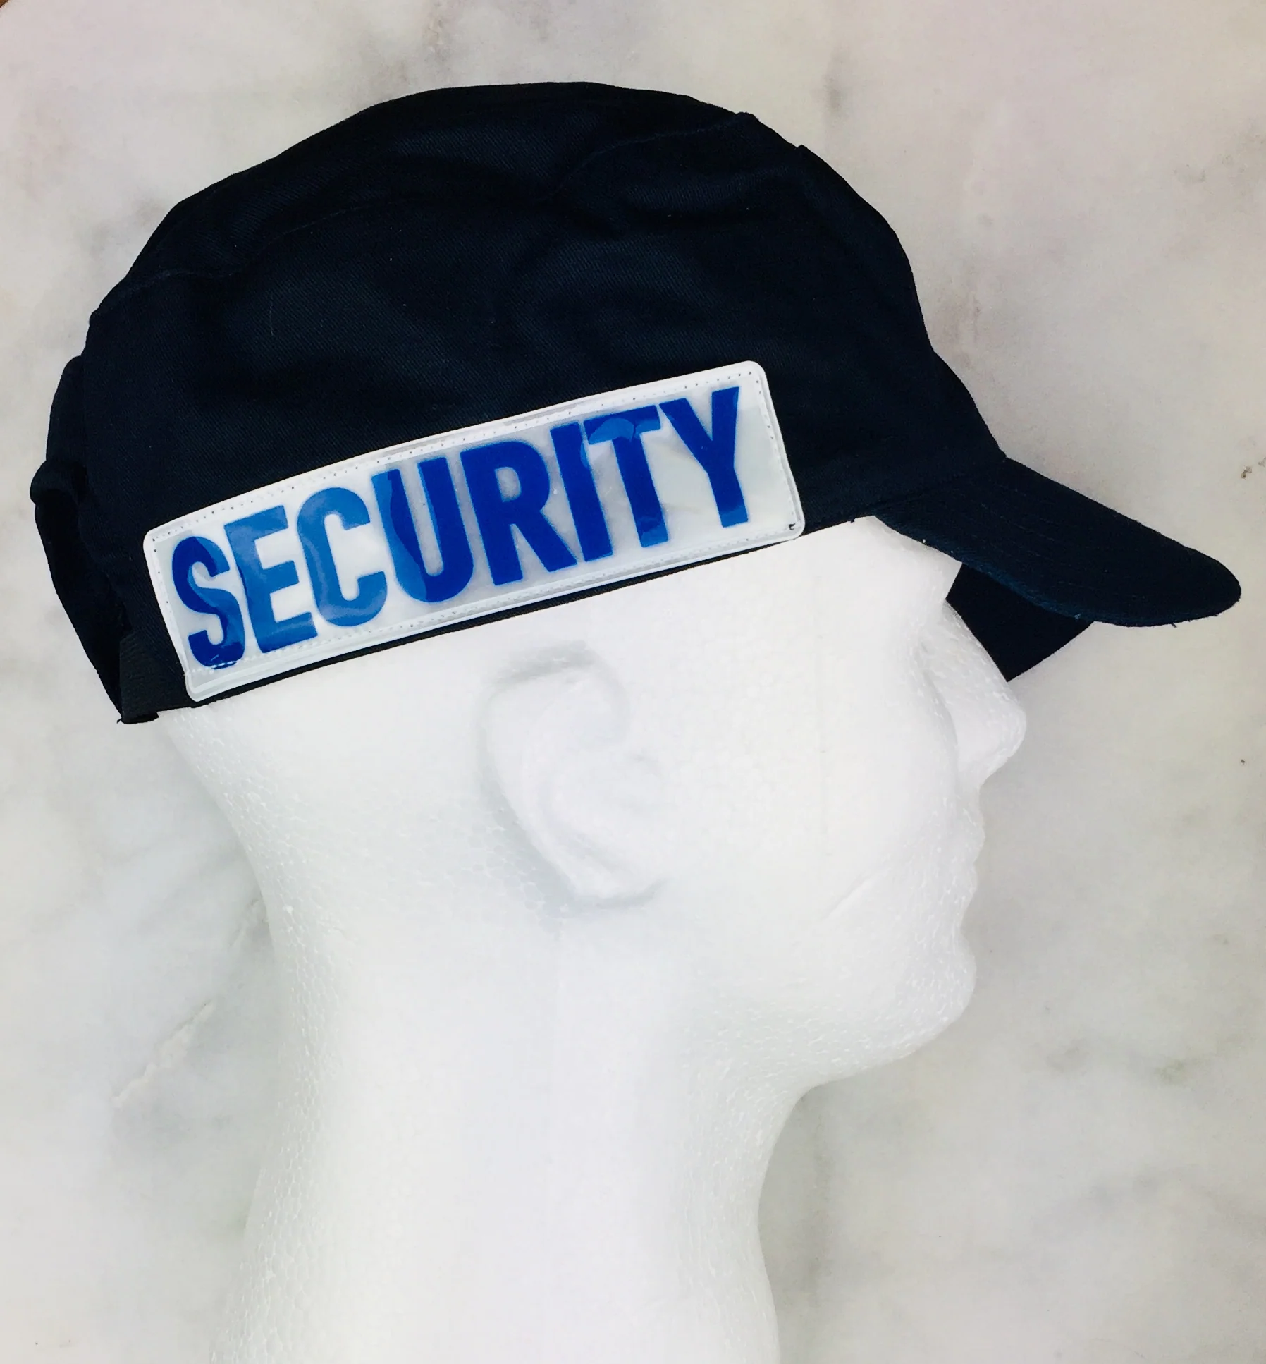
DEVELOPER
Notes:
Art from https://www.pdclipart.org/thumbnails.php Public domain

Slide 36


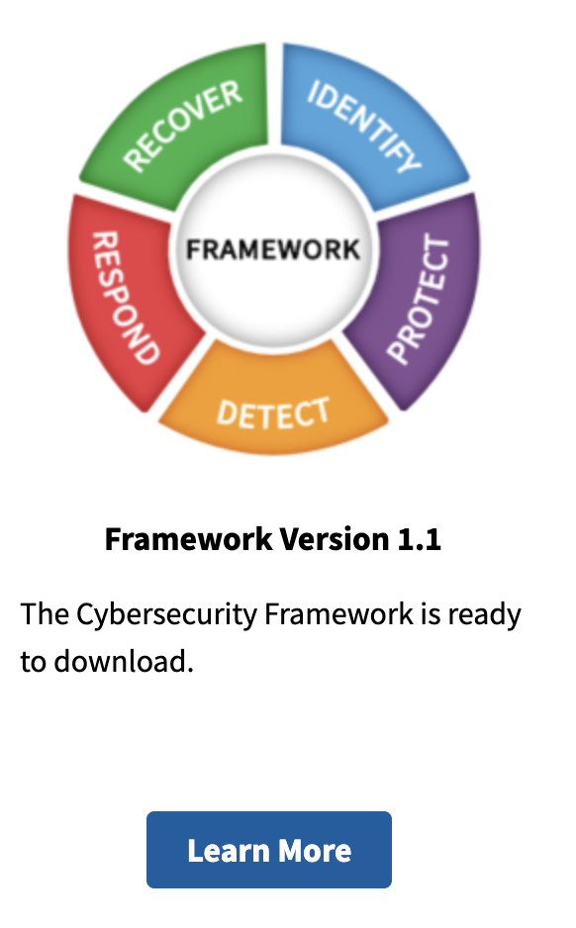
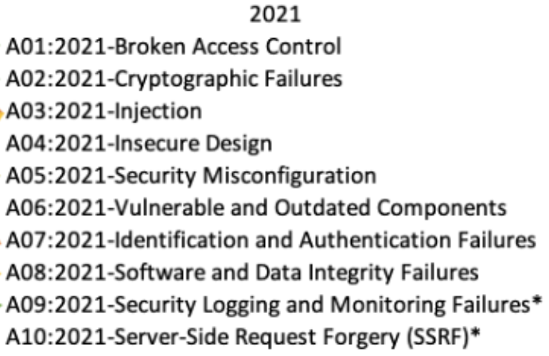
Notes:
Art from https://www.pdclipart.org/thumbnails.php Public domain

Slide 37
Notes:
Art from https://www.pdclipart.org/thumbnails.php Public domain

Slide 38
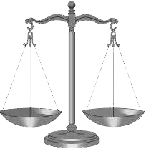


But Devs Already Have A Lot To Worry About:
Delivery deadlines
Billable hours
Number of tickets closed
Bugs
DevOps
Fighting Kubernetes
Only so much time
Notes:
Art from https://www.pdclipart.org/thumbnails.php Public domain

Slide 39
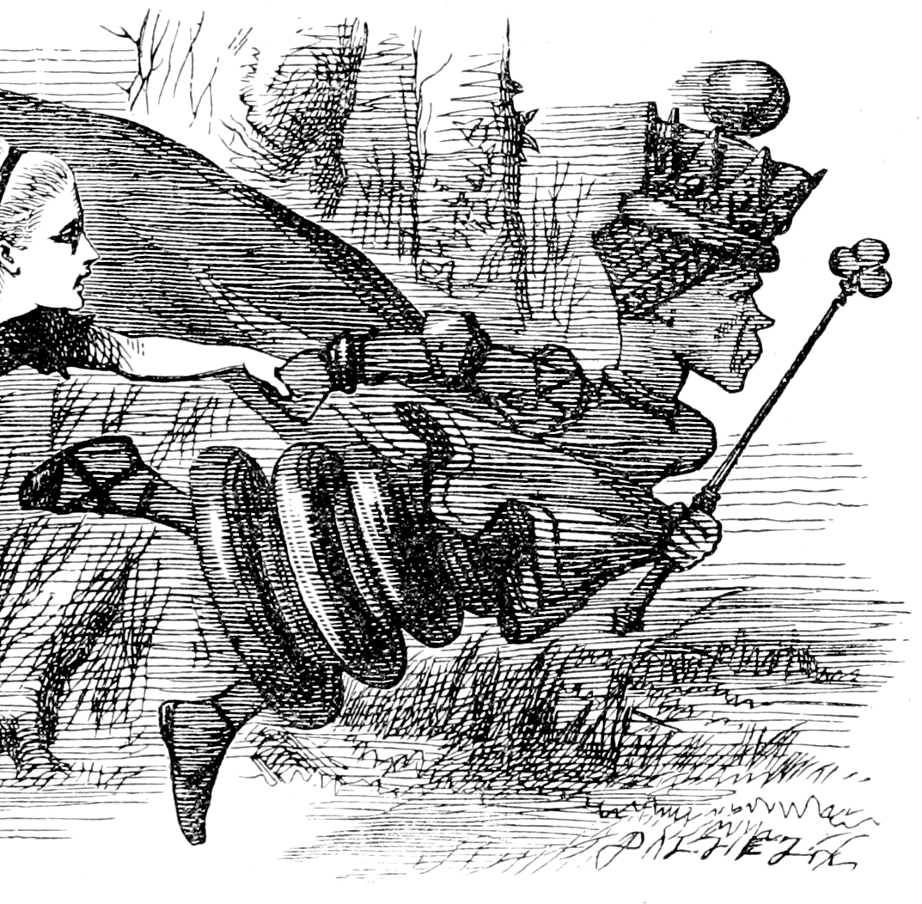
Now, here, you see, it takes all the running you can do, to keep in the same place. If you want to get somewhere else, you must run at least twice as fast as that!
― The Red Queen, Through the Looking-Glass, and What Alice Found There
Notes:
https://en.wikipedia.org/wiki/Red_Queen%27s_race Public domain

Slide 40
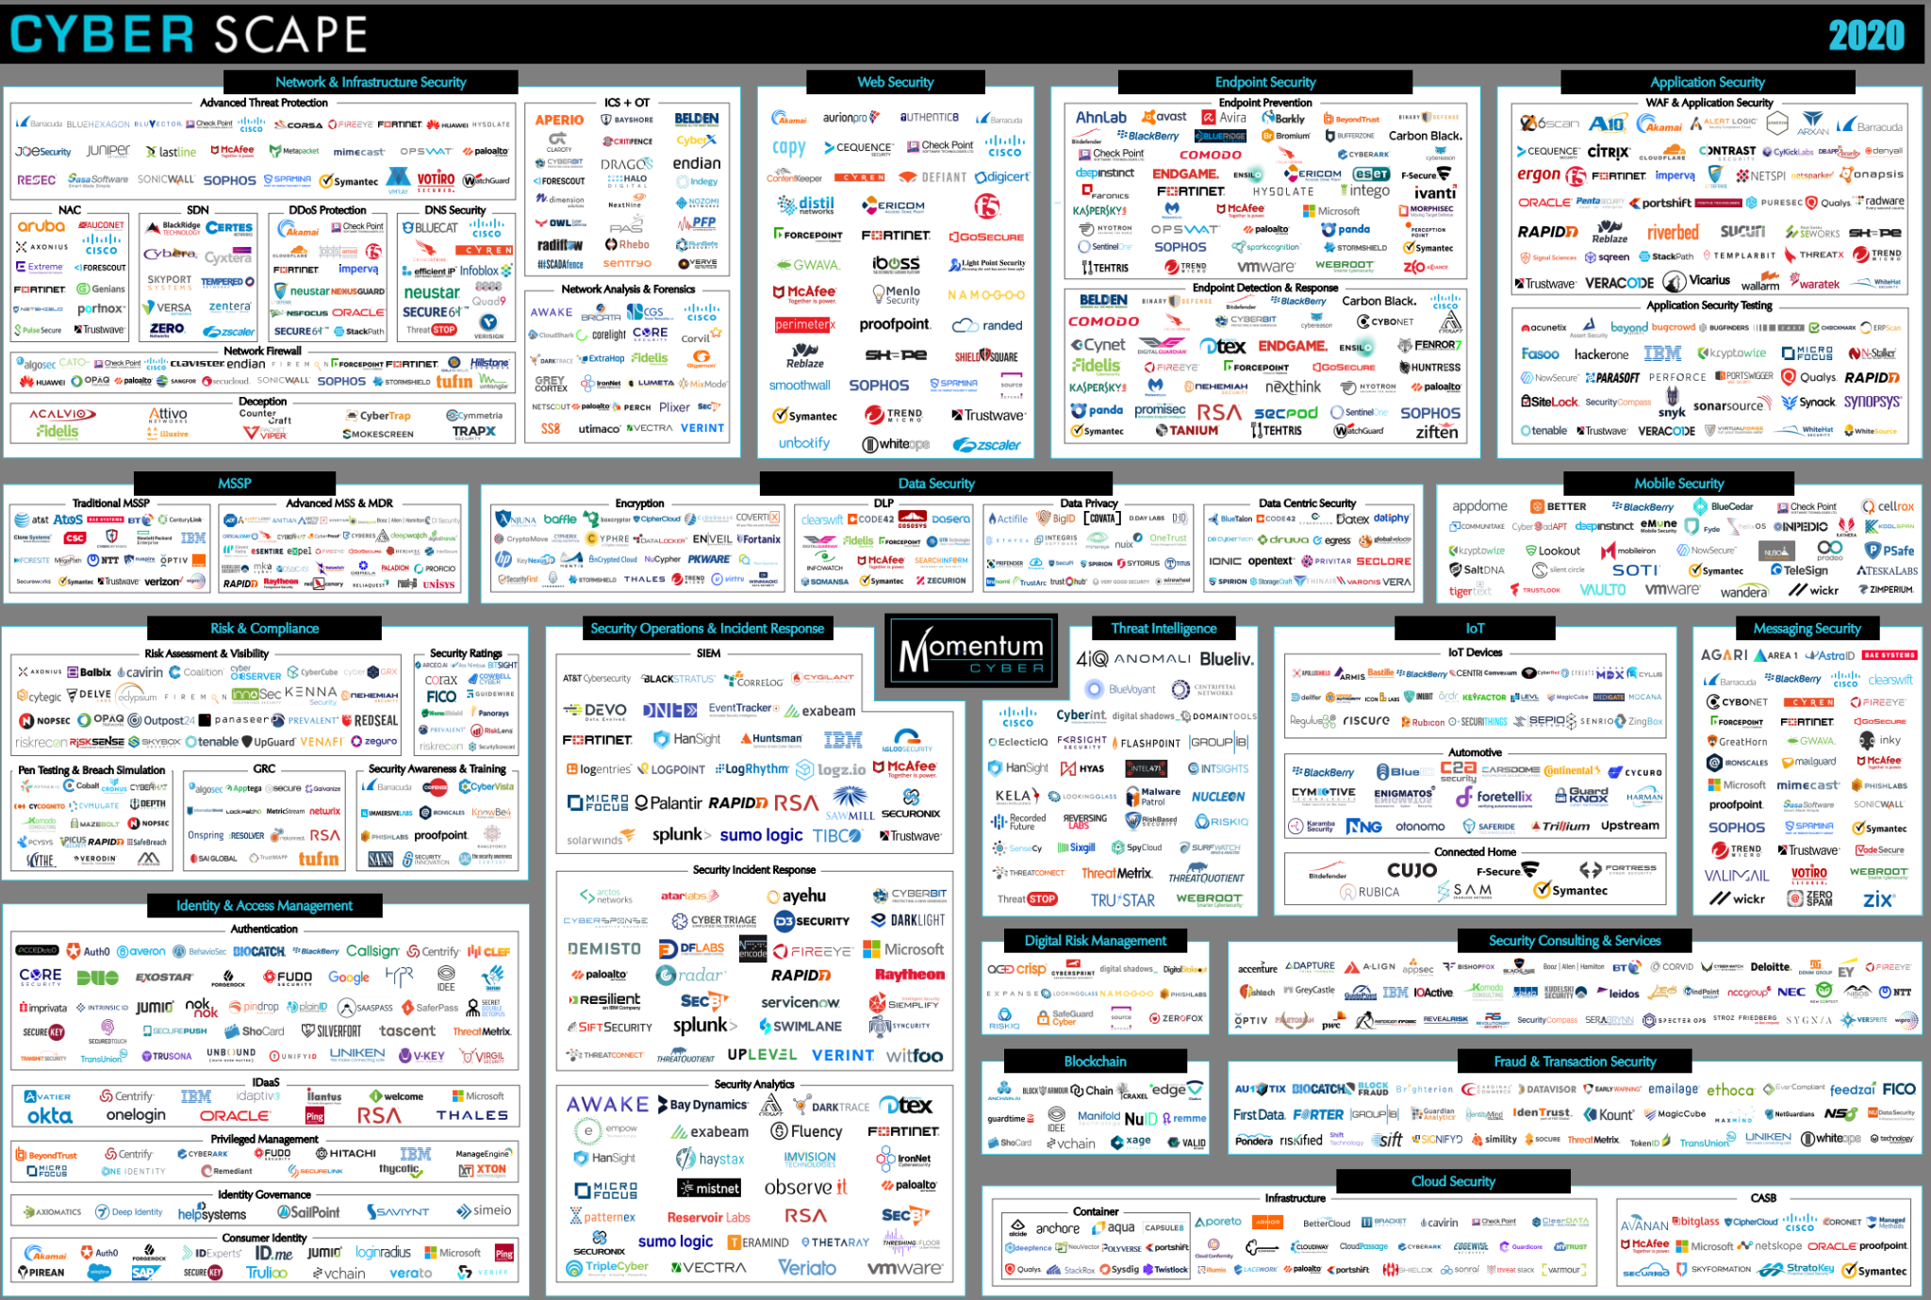
The Number Of Security Tools Is Overwhelming
Notes:
https://www.guidepointsecurity.com/wp-content/uploads/2019/08/CYBERscape.pdf https://www.guidepointsecurity.com/blog/6-best-practices-evaluating-cybersecurity-tools/

Slide 41
Devs vs. Security vs. Operations vs. Business ⚙⚙⚙⚙⚙⚙⚙⚙⚙⚙⚙⚙⚙⚙⚙⚙⚙⚙⚙⚙⚙⚙⚙⚙ 🕺🕺🕺🕺🕺🕺🕺🕺🕺🕺🕺🕺🕺🕺🕺🕺🕺🕺🕺🕺
🕺🕺🕺🕺🕺🕺🕺🕺🕺🕺🕺🕺🕺🕺🕺🕺🕺🕺🕺🕺
🕺🕺🕺🕺🕺🕺🕺🕺🕺🕺🕺🕺🕺🕺🕺🕺🕺🕺🕺🕺🚨
🕺🕺🕺🕺🕺🕺🕺🕺🕺🕺🕺🕺🕺🕺🕺🕺🕺🕺🕺🕺
🕺🕺🕺🕺🕺🕺🕺🕺🕺🕺🕺🕺🕺🕺🕺🕺🕺🕺🕺🕺 $$$$$$$$$$$$$$$$$$$$$$$$$$

Slide 42
Business Priority View of Security
Security Incident
Security Incident
Focus On New Feature Delivery Times
Focus On Security
Delivery Slows Down
Notes:
Art from https://www.pdclipart.org/thumbnails.php Public domain

Slide 43





We Are All On The Same Team
Notes:
https://en.wikipedia.org/wiki/The_A-Team_(season_4)

Slide 44
How do we add security everywhere?
Notes:
https://unsplash.com/photos/MtBsjmC4RT0

Slide 45
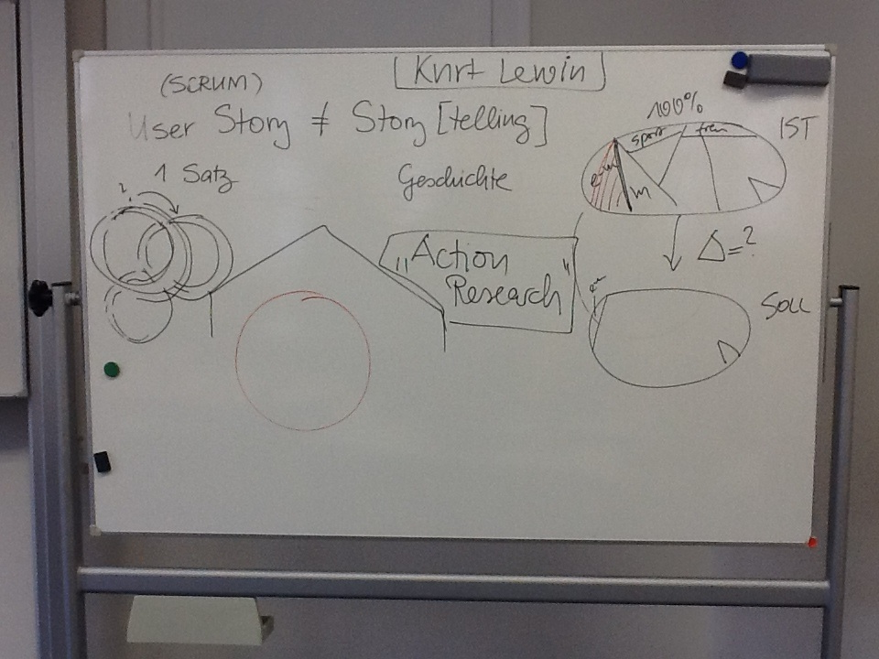
Shifting Left = Security At Every Stage
Especially At The Beginning
Notes:
https://commons.wikimedia.org/wiki/File:Change_management_whiteboard.jpg

Slide 46

Notes:
https://www.amazon.sg/Mobile-Whiteboard-Magnetic-Double-Sided-Rolling/dp/B083NC6SPZ?th=1

Slide 47
A Security Champion is a member of a team that takes on the responsibility of acting as the primary advocate for security within the team and acting as the first line of defense for security issues within the team.
Tanya Janca, WeHackPurple
https://wehackpurple.com/building-security-champions/
https://owasp.org/www-project-security-champions-guidebook/
Security Champion
Notes:
https://www.amazon.sg/Mobile-Whiteboard-Magnetic-Double-Sided-Rolling/dp/B083NC6SPZ?th=1

Slide 48
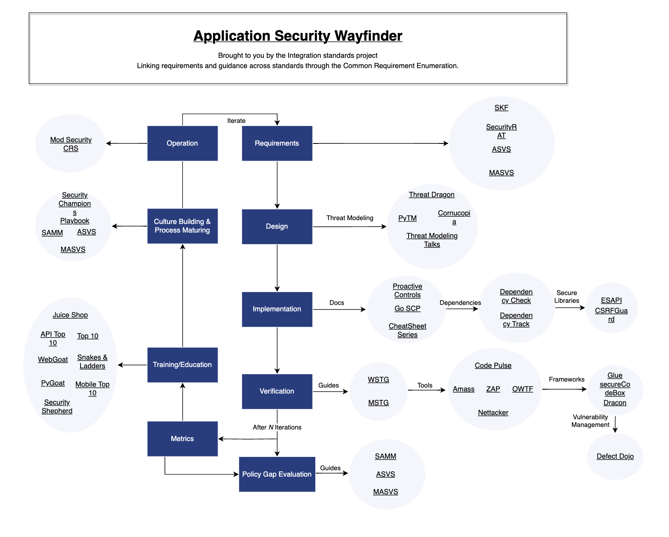
https://owasp.org/projects/
Notes:
https://en.wikipedia.org/wiki/The_A-Team_(season_4)

Slide 49
Meet with security team leads to review overall plan
Gather security requirements early
Ask for testing plan guidance
Walk through data flow to identify needed security authorizations and any compliance issues
Establish communication plan as planing evolves
Integrating Security Into
Notes:
https://unsplash.com/photos/MtBsjmC4RT0

Slide 50
Get sign off that the security team will review:
Local tools for security risks
Environments and server requirements
Plans for passing compliance, including meeting software composition analysis standards
Integrating Security Into
Notes:
https://unsplash.com/photos/MtBsjmC4RT0

Slide 51
Get the security team involved to
Seek out design vulnerabilities
Sign off on tech stack versions needed
Identify misuse cases and design tests for 'bad actors'
Perform a threat-and-risk model assessment
Integrating Security Into
Notes:
https://unsplash.com/photos/MtBsjmC4RT0

Slide 52
Security team and devs together can:
Automate security testing as early as possible (think local git hooks to trigger tests, SAST, SCA)
Communicate regularly as requirements and architecture evolves (is this older version still safe?)
Ensure only sanitized data is in use
Ask for security tooling reviews
Integrating Security Into
Notes:
https://unsplash.com/photos/MtBsjmC4RT0

Slide 53
In Conclusion

Slide 54
We Need To Act As One Team
Notes:
https://en.wikipedia.org/wiki/The_A-Team_(season_4)

Slide 55
Notes:
https://www.amazon.sg/Mobile-Whiteboard-Magnetic-Double-Sided-Rolling/dp/B083NC6SPZ?th=1

Slide 56
A Security Champion is a member of a team that takes on the responsibility of acting as the primary advocate for security within the team and acting as the first line of defense for security issues within the team.
Tanya Janca, WeHackPurple
https://wehackpurple.com/building-security-champions/
https://owasp.org/www-project-security-champions-guidebook/
Security Champion
Notes:
https://www.amazon.sg/Mobile-Whiteboard-Magnetic-Double-Sided-Rolling/dp/B083NC6SPZ?th=1

Slide 58
Notes:
https://unsplash.com/photos/MtBsjmC4RT0

Slide 59
Hi, I’m Dwayne
I live in Chicago
I’ve been a Developer Advocate since 2016
Co-host of The Security Repo Podcast
On Twitter @mcdwayne
mcdwayne@mastodon.social
Happy to chat about anything, hit me up
Outside of tech, I love improv, karaoke and going to rock and roll shows!
Dwayne McDaniel

Slide 60
Scaling Security:
What Shifting Left
Was Supposed
To Mean

Slide 61
DORA Metrics Basics
Deployment Frequency
Deployment frequency refers to the cadence of an organization’s successful releases to production.
How often code is deployed to production? How often it is released to end users? High performers use continuous deployment, CD, to achieve multiple deployments per day.
Notes:
https://unsplash.com/photos/MtBsjmC4RT0

Slide 62
DORA Metrics Basics
2. Mean Lead Time for Changes
Mean lead time for changes measures how long it takes a commit to get into production.
This is essentially a health metric for the teams’ cycle time. Is this fast enough for current progress? Can they handle a sudden influx of requests?
Another way to think about MLTC is as your DevOps practice’s velocity.
Notes:
https://unsplash.com/photos/MtBsjmC4RT0

Slide 63
DORA Metrics Basics
3. Mean Time To Recover
How long does it take a team to restore service in the event of an unplanned outage or another incident?
This is really a measure of stability of your whole practice and systems. It is critical to be able to restore service as quickly as possible (with a low mean time to recover).
High performers improve this metric with the help of robust monitoring and the implementation of progressive delivery practices.
Notes:
https://unsplash.com/photos/MtBsjmC4RT0

Slide 64
DORA Metrics Basics
4. Change Failure Rate
How often does making changes lead to failures in production.
Any work resulting from a failed deployment to prod, including fix time or root cause analysis, counts toward the change failure rate.
Since this is all time diverted from delivering business value, this metric helps you see where to invest in infrastructure to support your DevOps practice.
Notes:
https://unsplash.com/photos/MtBsjmC4RT0

